Slide 1
Wage Differences According to Workers’ Origin: The Role of Working More Upstream in GVCs
V. Fays, B. Mahy and F. Rycx
The 9th of January 2022
LERA@ASSA 2022

Slide 2
Introduction
Extended literature about wages and wage gap according to workers’ origin (Borjas, 1985; Nanos & Schluter, 2014; OECD, 2017).
Small but growing literature studying wage gaps according to workers’ origin and Global Value Chains (GVCs).
Different empirical studies test the relationship between different aspects of firms’ globalization (e.g. offshoring, participation or involvement in GVCs) and wages (Hummels et al., 2016; Shepherd, 2013; Parteka & Wolszczak-Derlacz, 2019).
One particular aspect of globalization receives increasing attention : firm’s upstreamness.
Firm’s upstreamness = the number of steps before firms’ products meet final demand.

Slide 3
Literature review
A higher firm’s upstreamness seem to generate more added value (De Backer and Miroudot, 2013; Dhyne et al., 2015; Ju & Yu, 2015; Mahy et al., 2021).
But little is known on whether and to what extent the productivity gains associated with a firm’s position in GVCs are (equally) shared with its workers.
Results suggest that a higher upstreamness leads to higher wages, especially for men (Gagliardi, 2021) and highly educated workers (Shen and Silva, 2018) but also to within-firm inequality (Chen, 2017).
To our knowledge, the moderating role of workers’ origin in the relationship between upstreamness and wages has not been studied so far.

Slide 4
Motivation & research question
It is very likely that upstreamness plays a role in explaining wage gaps according to workers’ origin due to:
unequal distribution of native and immigrant workers into different stages of supply chains (Barrientos et al., 2011; Gereffi & Luo, 2014), and
wage discrimination based on origin (Cattaneo et al., 2015; Tomaskovic-Devey et al., 2015; Fays et al., 2021).
Research question:
What is the contribution of upstreamness to wages and wage gaps between workers born in developed countries and workers born in developing countries?

Slide 5
Data
Matched employer-employee pooled cross-sectional dataset with 245,418 year-observations, which is representative of all workers employed in manufacturing firms employing at least 10 workers over the period 2002-2010 in Belgium.
Table 1: Means of variables of interest, overall and by origin
Variables | All workers (1) | Workers born in developed countries (2) | Workers born in developing countries (3)
Gross hourly wage (€, at constant 2004 prices) | 16.52 | 16.61 | 14.74
Upstreamness | 2.71 | 2.71 | 2.57
Workers born in developed countries (%) | 95.1 | 100
Workers born in developing countries (%) | 4.9 |  | 100
Number of observations | 245,418 | 233,432 | 11,986

Slide 6
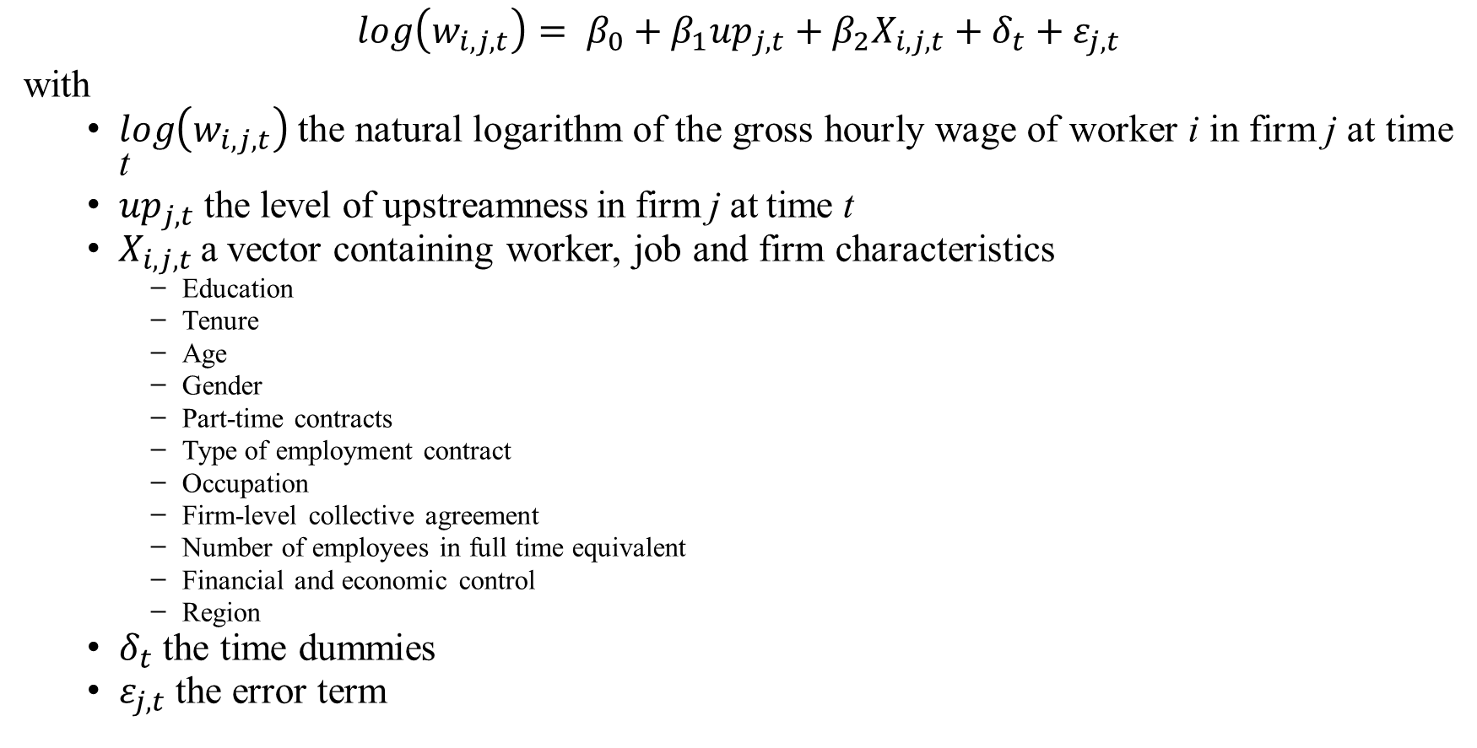
Method
$$\log\left(w_{i,j,t}\right)= β_{0}+β_{1}{up}_{j,t}+β_{2}X_{i,j,t}+δ_{t}+ε_{j,t}$$
with
$\log\left(w_{i,j,t}\right)$the natural logarithm of the gross hourly wage of worker i in firm j at time t
${up}_{j,t}$the level of upstreamness in firm j at time t
$X_{i,j,t}$ a vector containing worker, job and firm characteristics
Education
Tenure
Age
Gender
Part-time contracts
Type of employment contract
Occupation
Firm-level collective agreement
Number of employees in full time equivalent
Financial and economic control
Region
$δ_{t}$ the time dummies
$ε_{j,t}$the error term

Slide 7
Main findings (1)
Table 2: OLS and Unconditional Quantile Regressions for workers born in developed countries and workers born in developing countries
 | Workers born in developed countries
Dependent variable: logarithm of the gross hourly wage | OLS | Block Bootstrap Unconditional Quantile estimates
 | (Mean) | (0.25) | (0.5) | (0.75)
Upstreamness | 0.021*** (0.002) | 0.016*** (0.002) | 0.019*** (0.002) | 0.031*** (0.004)
 | Workers born in developing countries
Dependent variable: logarithm of the gross hourly wage | OLS | Block Bootstrap Unconditional Quantile estimates
 | (Mean) | (0.25) | (0.5) | (0.75)
Upstreamness | 0.020*** (0.527) | 0.014*** (0.004) | 0.013*** (0.003) | 0.018*** (0.005)
Number of observations for:
Workers born in developed countries | 233,432 | 233,432 | 233,432 | 233,432
Workers born in developing/transition countries | 11,986 | 11,986 | 11,986 | 11,986
Data source: SES-NR-NBB B2B 2002-2010. ***, **, * significant at 1, 5 and 10% levels, respectively.
Notes:
A higher level of upstreamness leads to higher wages for native and migrant workers in the same order of magnitude (1 step further from final demand ➔ +2% wages)
However, upstreamness returns are not equally distributed along the wage distribution.
top-wage workers born in developed countries benefit the most from an increase of upstreamness

Slide 8
Robustness test
Table 3: OLS and unconditional quantile regressions, by origin and firms’ technological and knowledge intensity
Dependent variable: logarithm of the gross hourly wage | Number of observations (as % of total workers by origin − in HT-KIS firms) | High technological and knowledge intensity firms
 |  | OLS | Unconditional quantile estimates
 |  | (Mean) | (0.25) | (0.5) | (0.75)
Upstreamness (sample of workers born in developed countries) | 86,552 (37% − 96%) | 0.027*** (0.004) | 0.018*** (0.003) | 0.029*** (0.004) | 0.047*** (0.006)
Upstreamness (sample of workers born in developing countries) | 3,911 (33% − 4%) | 0.027*** (0.006) | 0.017*** (0.006) | 0.018*** (0.006) | 0.028** (0.011)
 | Number of observations (as % of total workers by origin − in LT-LKIS firms) | Low technological and knowledge intensity firms
 |  | OLS | Unconditional quantile estimates
 |  | (Mean) | (0.25) | (0.5) | (0.75)
Upstreamness (sample of workers born in developed countries) | 146,880 (63% − 95%) | 0.018*** (0.002) | 0.018*** (0.002) | 0.018*** (0.002) | 0.022*** (0.004)
Upstreamness (sample of workers born in developing countries) | 8,075 (67% − 5%) | 0.016*** (0.004) | 0.014*** (0.004) | 0.014*** (0.005) | 0.010* (0.005)

Slide 9
Main findings (2)
Table 4: Oaxaca-Blinder Decomposition à la Fortin et al. of the wage gap according to origin
 | OLS | Unconditional Quantile estimates
 | (Mean) | (0.25) | (0.5) | (0.75)
Wage gap according to origin (in log) | 0.104 | 0.075 | 0.100 | 0.149
Magnitude (in %)
Compositional effect of upstreamness (explained part) | 2.9 | 2.7 | 2.0 | 3.4
Wage structure effect of upstreamness (unexplained part) | 11.5 | 14.7 | 27.0 | 51.0
Data source: SES-NR-NBB B2B 2002-2010
Notes:
Interpréter tests d’endogénéité

Slide 10
Conclusion
A higher level of upstreamness leads to higher wages for workers born in developed and developing countries in the same order of magnitude.
But upstreamness returns are not equally distributed along the wage distribution.
Top-wage workers born in developed countries benefit the most from an increase of upstreamness, leaving behind workers born in developing countries but also low-wage workers born in developed countries.
When analysing the wage decomposition, the explained part of the wage gap linked with upstreamness is small and constant along the wage distribution, while the unexplained part of the wage gap linked with upstreamness is more substantial and grows along the wage distribution.

Slide 11
Conclusion
Results hold when testing for:
endogeneity,
different wage definitions,
different technology environments, and
when using firm-level panel data (all results available on request).
These results might be explained by non-productive factors:
Ethnic segregation in performance-related pay (Fang & Heywood, 2010);
Lower bargaining power characterizing migrant workers (Tomaskovic-Devey et al., 2015);
Discrimination as suggested by Fays et al. (2021).

Slide 12
Thank you for your attention!
valentine.fays@umons.ac.be
benoit.mahy@umons.ac.be
frycx@ulb.be

Slide 13
Robustness test
Table 5: OLS and 2SLS regressions, overall and by origin
Estimation technique | OLS |  |  |  | 2SLS
Dependent variable: logarithm of the gross hourly wage |  | All workers (1) | Workers born in developed countries (2) | Workers born in developing countries (3) | All workers (4) | Workers born in developed countries (5) | Workers born in developing countries (6)
Upstreamness^{A} |  | 0.021*** (0.002) | 0.021*** (0.002) | 0.020*** (0.527) | 0.036*** (0.006) | 0.036*** (0.006) | 0.029* (0.016)
Control variables^{B} |  | Yes | Yes | Yes | Yes | Yes | Yes
Adjusted R² |  | 0.56 | 0.561 | 0.527 | 0.56 | 0.558 | 0.525
Model sig. (p-value of F test) |  | 0.0 | 0.0 | 0.0 | 0.0 | 0.0 | 0.0
Number of observations |  | 245,418 | 233,432 | 11,986 | 245,418 | 233,432 | 11,986
Diagnoses tests for 2SLS:
Underidentification test^{C} p-value Kleibergen-Paap rk LM statistic |  |  |  |  | 0.00 | 0.00 | 0.00
Weak identification test^{D} Kleibergen-Paap rk Wald F statistic |  |  |  |  | 144.1 | 140.2 | 56.4
Endogeneity test^{E} p-value Durbin-Wu-Hausman χ² statistic |  |  |  |  | 0.14 | 0.17 | 0.35

Slide 14
Robustness test
Table 6: OLS and unconditional quantile regressions (UQR), by origin using different components of workers’ wages as dependent variable
 | Workers born in developed countries
 | OLS | Unconditional quantile estimates
 | (Mean) | (0.25) | (0.5) | (0.75)
Upstreamness (using gross hourly wages, benchmark specifications) | 0.021*** (0.002) | 0.016*** (0.002) | 0.019*** (0.002) | 0.031*** (0.004)
Upstreamness (using gross hourly wages excluding: overtime compensation and premia for shift/night/weekend work) | 0.016*** (0.002) | 0.013*** (0.002) | 0.017*** (0.003) | 0.021*** (0.003)
Upstreamness (using gross hourly wages excluding: overtime compensation, premia for shift/night/weekend work, performance-related pay and commissions, and annual and irregular bonuses) | 0.011*** (0.002) | 0.009*** (0.002) | 0.014*** (0.002) | 0.019*** (0.003)
 | Workers born in developing countries
 | OLS | Unconditional quantile estimates
 | (Mean) | (0.25) | (0.5) | (0.75)
Upstreamness (using gross hourly wages, benchmark specifications) | 0.020*** (0.527) | 0.014*** (0.004) | 0.013*** (0.003) | 0.018*** (0.005)
Upstreamness (using gross hourly wages excluding: overtime compensation and premia for shift/night/weekend work) | 0.018*** (0.004) | 0.016*** (0.005) | 0.013** (0.005) | 0.011** (0.004)
Upstreamness (using gross hourly wages excluding: overtime compensation, premia for shift/night/weekend work, performance-related pay and commissions, and annual and irregular bonuses) | 0.015*** (0.004) | 0.011** (0.004) | 0.013*** (0.005) | 0.015** (0.005)

Slide 15
Robustness test
Table 7: Firm-level OLS and FE estimates
Dependent variable: logarithm of firm-level average gross hourly wage | OLS (1) | FE (2) | FE (3)
Firm-level upstreamness^{A} | 0.016*** (0.002) | 0.015*** (0.002) | 0.013*** (0.002)
Firm-level upstreamness x dummy = 1 if the firm-level share of full-time equivalent workers born in developing countries is above the sample average |  |  | 0.007 (0.004)
Dummy = 1 if the firm-level share of full-time equivalent workers born in developing countries is above the sample average |  |  | -0.024** (0.012)
Control variables^{B} | Yes | Yes | Yes
Number of observations | 10,058 | 10,058 | 10,058

