Slide 1


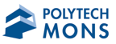
Efficiency and durability of a bioactive coating in formaldehyde degradation
Cristiana C. Castro, Tangi Senechal, Julian Viseur,
Ducoulembier Aline, Driss Lahem, Anne-Lise Hantson
18 September 2019

Slide 2
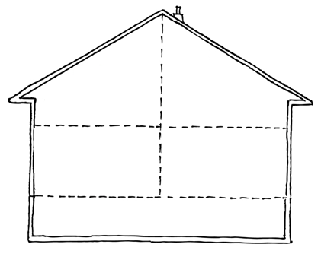











Problem
Indoor air pollution
Health and comfort concerns
Main contaminants
  Mold and bacteria
  Dust and other allergens
  Gases (NO, CO and CO₂)
  Chemicals and solvents
VOCs
Legislation limits
VOCs: Volatile organic compunds
HANTSON Anne-Lise| Applied Chemistry and Biochemistry Department, Faculty of Engineering, UMONS

Slide 3
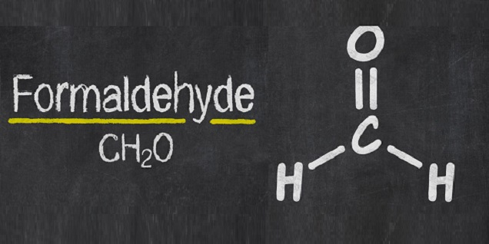




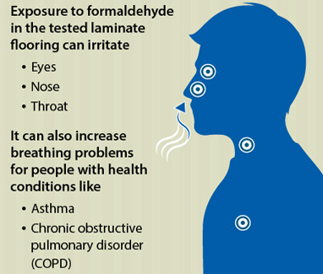
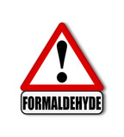
Formaldehyde
> 0.3 ppm
≈ 4 h
Eyes, nose and throat irritation
Breathing difficulties
Respiratory injuries
Chronic pulmonary obstruction
Pulmonary cancer
Construction materials
Wood processing
Furniture
Textiles
Carpeting
Cleaning products
Concentration
Exposure time
FA
Immunogenic
Carcinogenic
Mutagenic
Allergenic
HANTSON Anne-Lise| Applied Chemistry and Biochemistry Department, Faculty of Engineering, UMONS

Slide 4

Technology and Innovation
Technology
Innovation
Capture and degradation of contaminants by encapsulated microorganisms and/or biomolecules
Placement of the wet coating on structural elements (ventilation ducts, ceiling tales, glazed areas)
Environmental and health friendly technology
Durable and rechargeable
Odors
VOCs
Mold
Bacteria
Gases
Surface
H₂O
O₂
CO₂
N₂
…
HANTSON Anne-Lise| Applied Chemistry and Biochemistry Department, Faculty of Engineering, UMONS

Slide 5


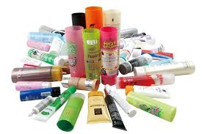
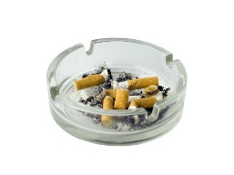

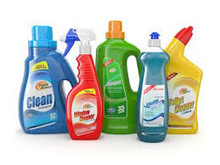
BIODEC Solution
Indoor DEpollution
Odors VOCs
Bacteria
Gases Mold
Bioactive Coating
Encapsulation:
Bioactive
molecules
Microorganisms
with depolluting
ability
Cosmetics
H₂O
O₂
CO₂
N₂
…
Smoking
Paints
Cleaning products
Furniture
HANTSON Anne-Lise| Applied Chemistry and Biochemistry Department, Faculty of Engineering, UMONS

Slide 6
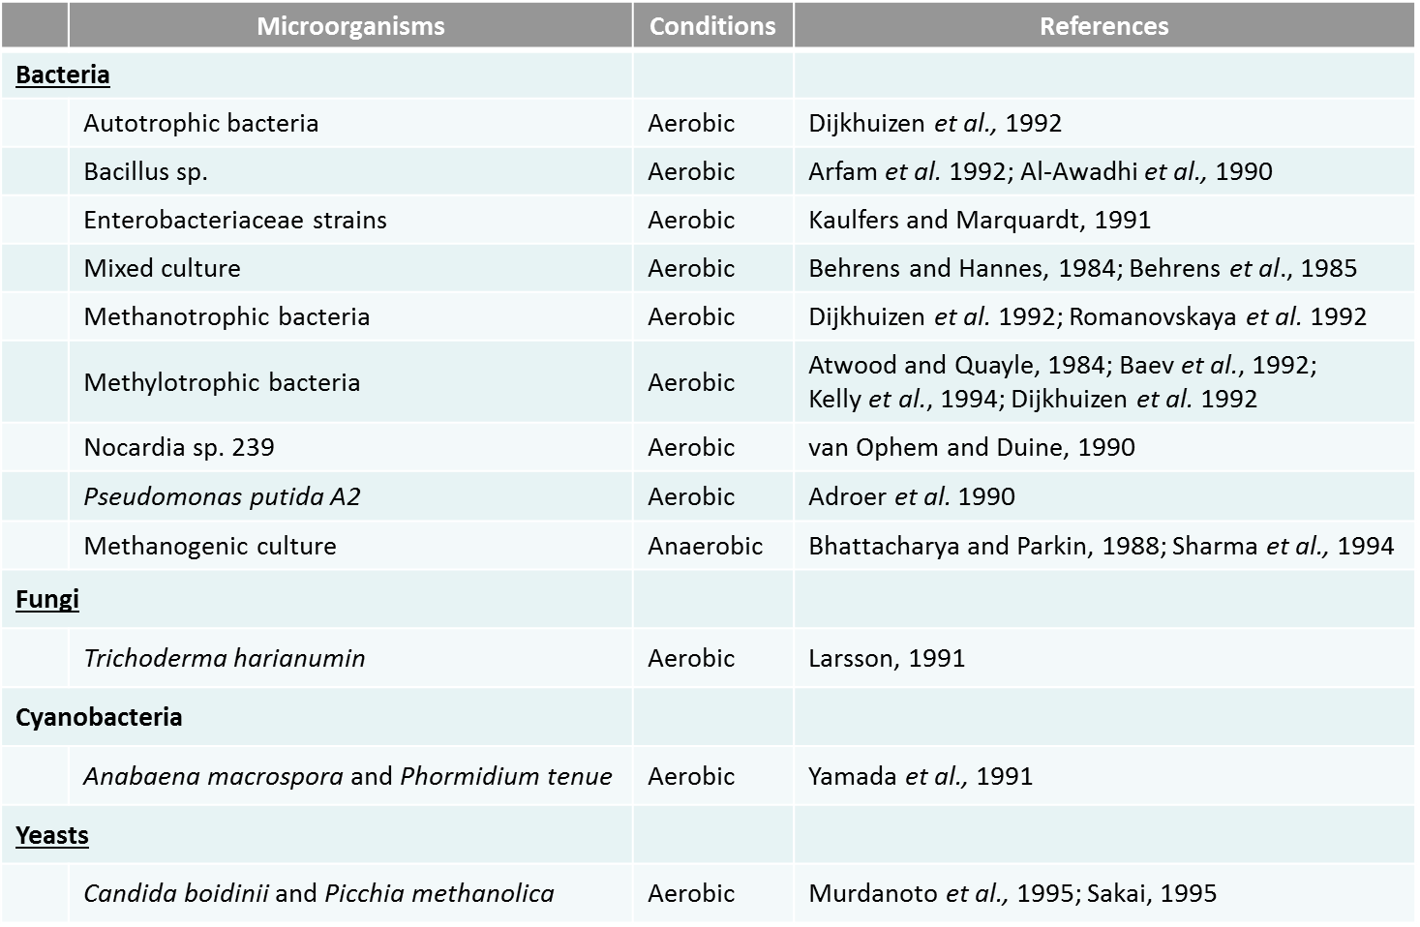
FA-degrading strains
HANTSON Anne-Lise| Applied Chemistry and Biochemistry Department, Faculty of Engineering, UMONS

Slide 7
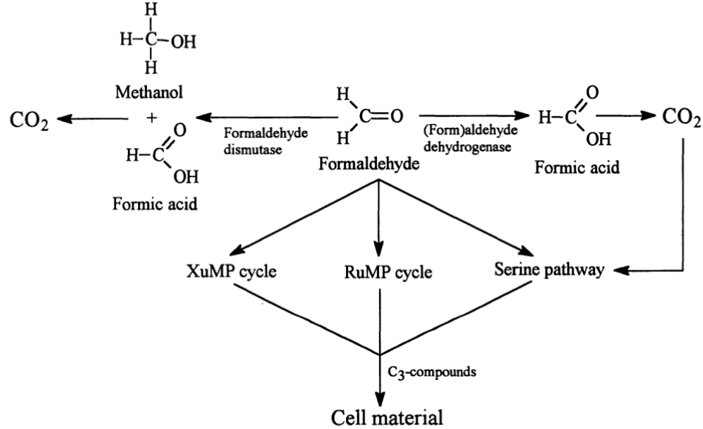
FA-degrading enzymes
Catabolic pathways
Anabolic pathways
HANTSON Anne-Lise| Applied Chemistry and Biochemistry Department, Faculty of Engineering, UMONS

Slide 8
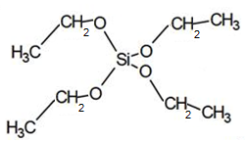
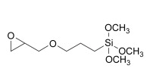
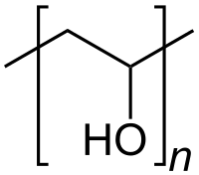
Coatings formulation
sol-gel coating
  Mechanical properties
  Control of the hydrophobicity
  Chemical resistance
  Durability
Enzymes viability
  Low temperature
  No alcohol
  No extreme pH
  No UV
  No Ultrasound
sol-gel coating - precursors
TEOS
GPTMS
PVOH
PEG
With water and acetic acid
HANTSON Anne-Lise| Applied Chemistry and Biochemistry Department, Faculty of Engineering, UMONS

Slide 9
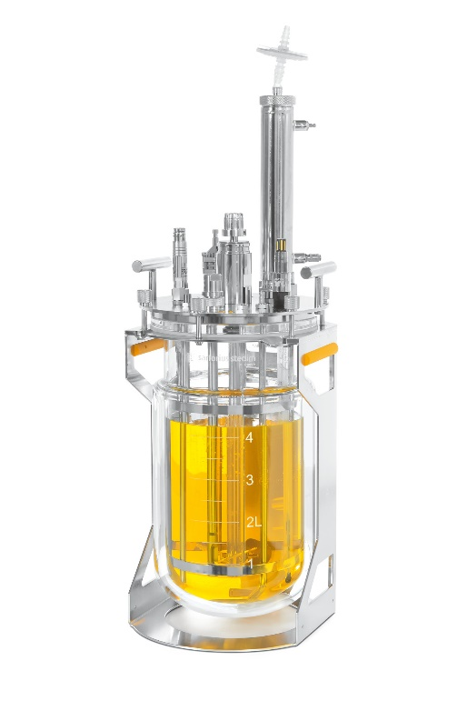
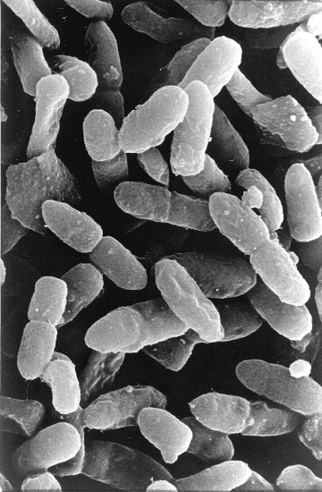
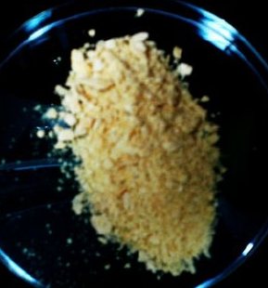

Microorganisms preparation
Freeze drying
Pseudomonas putida
Bioreactor production
Dried cells
No biological activity
Active enzymes
Water dispersible
HANTSON Anne-Lise| Applied Chemistry and Biochemistry Department, Faculty of Engineering, UMONS

Slide 10
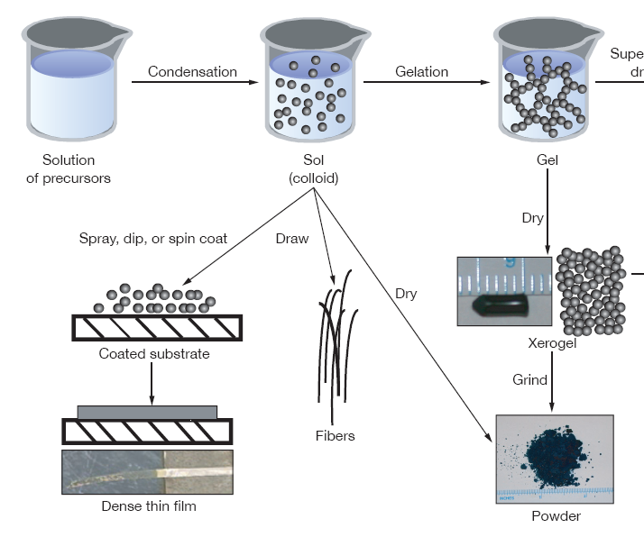
Coatings preparation
Incorporation of freeze-dried
Pseudomonas putida
Condensation
Solution
of precursors
Sol-gel
Spray
Coated substrate
(Thin-layer chromatography (TLC) paper)
Dense thin film
HANTSON Anne-Lise| Applied Chemistry and Biochemistry Department, Faculty of Engineering, UMONS

Slide 11
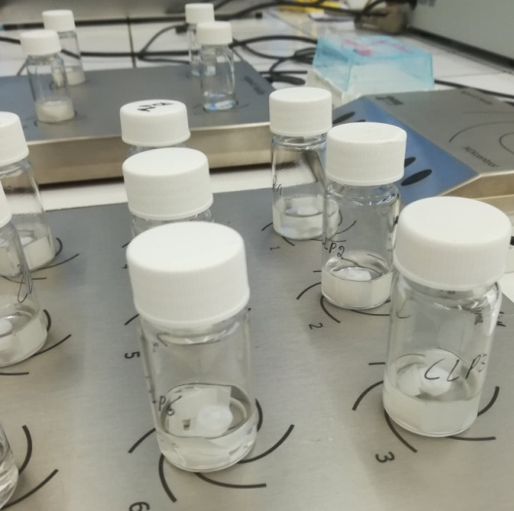
Experimental design – coatings formulation
Optimised experimental design (OED)
  3 variables: Sol-gel; PEG; [microorganism]
  2 levels
Responses:
  Max. FA degradation
Coatings were applied on the surface of the TLC paper according to OED
Coating deposition by spray
Number of application layers = 6
Reactional mixture (4 mL):
8 pieces of papier CCM (1 cm²)
1 mM Formaldehyde
1 mM NAD⁺
Carbonate buffer, pH = 10
HANTSON Anne-Lise| Applied Chemistry and Biochemistry Department, Faculty of Engineering, UMONS

Slide 12
FA degradation at room temperature (+/- 20°C)
24h after deposition
5 weeks after deposition
Optimal conditions: series 1 and 7
FA degradation yield is kept during 5 weeks for series 1 (~ 90%) and 7 (~ 77%)
Decrease of degradation yield for series 2 et 8
The presence of PEG in serie 1 allowed the retention of large contents of water that improved the activity of formaldehyde-degrading enzymes
HANTSON Anne-Lise| Applied Chemistry and Biochemistry Department, Faculty of Engineering, UMONS

Slide 13
Coatings durability
Deposition on TLC surface
HANTSON Anne-Lise| Applied Chemistry and Biochemistry Department, Faculty of Engineering, UMONS

Slide 14
Conclusions
Bioactive coatings containing freeze-dried bacterial cells were efficient in formaldehyde degradation in solution
The presence of PEG in the sol-gel improves the enzymatic degradation of the pollutant
Coatings storage at 37°C decreased formaldehyde degradation ability
Formaldehyde degradation efficiency can be kept by storing sol-gel coatings at room temperature
Further studies should be carried out to study the conservation of enzymes stability throughout time for industrial application of the bioactive coatings
HANTSON Anne-Lise| Applied Chemistry and Biochemistry Department, Faculty of Engineering, UMONS

Slide 15


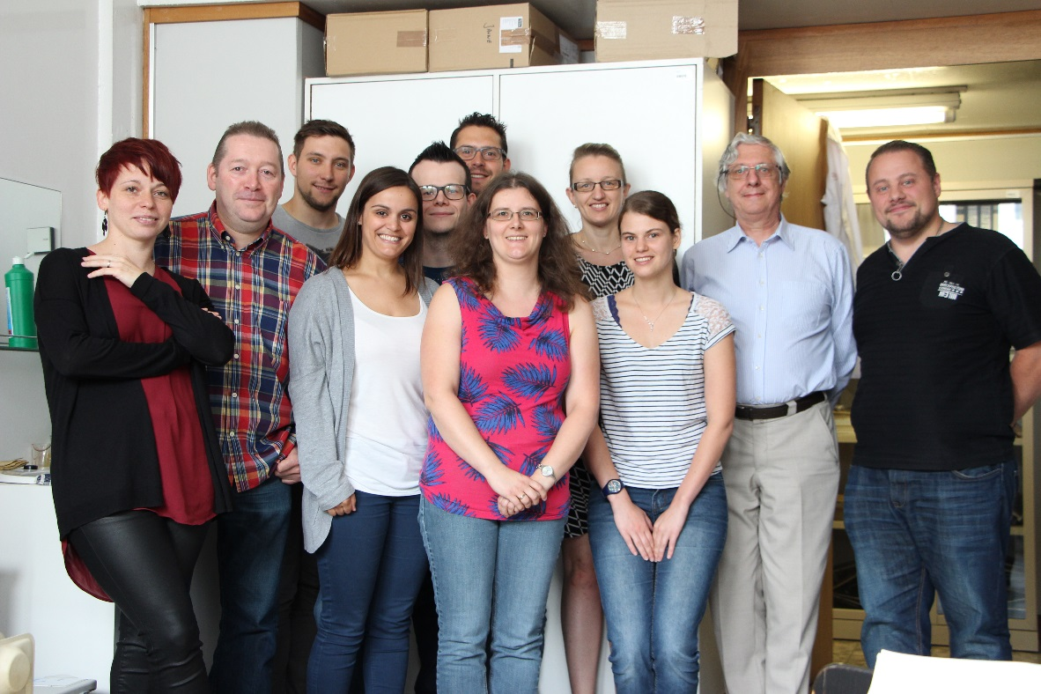






Aknowledgments
BIODEC collaborators
GPCB team
HANTSON Anne-Lise| Applied Chemistry and Biochemistry Department, Faculty of Engineering, UMONS

Slide 16

Questions?
HANTSON Anne-Lise| Applied Chemistry and Biochemistry Department, Faculty of Engineering, UMONS

