Slide 1
Second advice: how failure analysis of metallic components can bring very different results when carried out by different labs, while it should not.
Véronique Vitry¹
Victor Ioan Stanciu¹
Fabienne Delaunois¹
¹UMONS – POLYTECH
Notes:
Enter speaker notes here.

Slide 2
Why send failed, non litigious components to FA?
To avoid any further occurrences
Aim: understand the origins of failure
Failed sent parts to laboratories
Aim of this presentation
Show that the same failure case, analyzed by two laboratories
Have led to two different interpretation of the same results
How can it be so ?
Notes:
Enter speaker notes here.

Slide 3
The two case studies
Helicopter main rotor cyclic pitch control stick
Stainless steel chain link used in radiographic applications
Notes:
Enter speaker notes here.

Slide 4
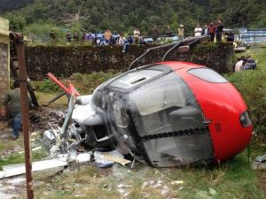
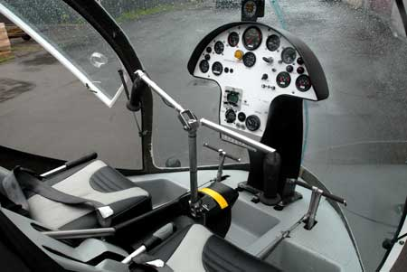
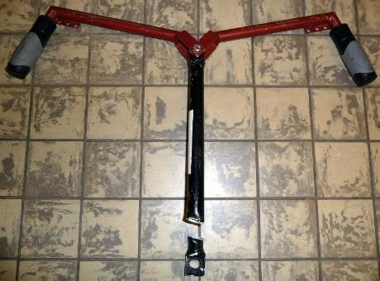
Case 1 : Helicopter main rotor cyclic pitch control stick
Reason for study : crash of the helicopter (no-one wounded, only material damage)
Cyclic stick
Notes:
Enter speaker notes here.

Slide 5
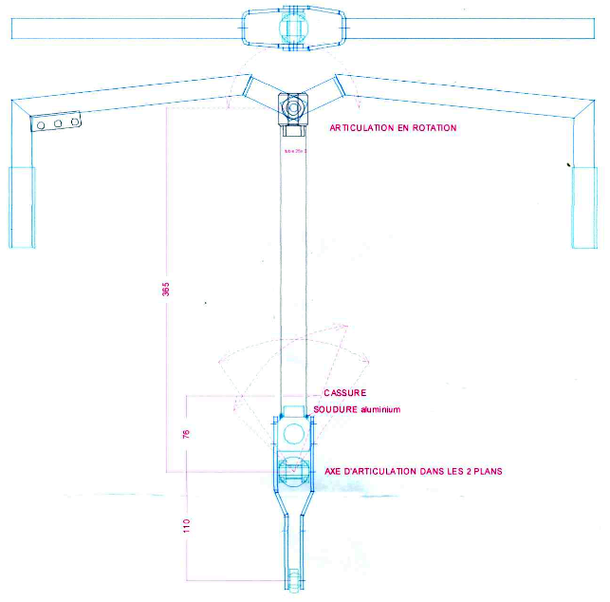
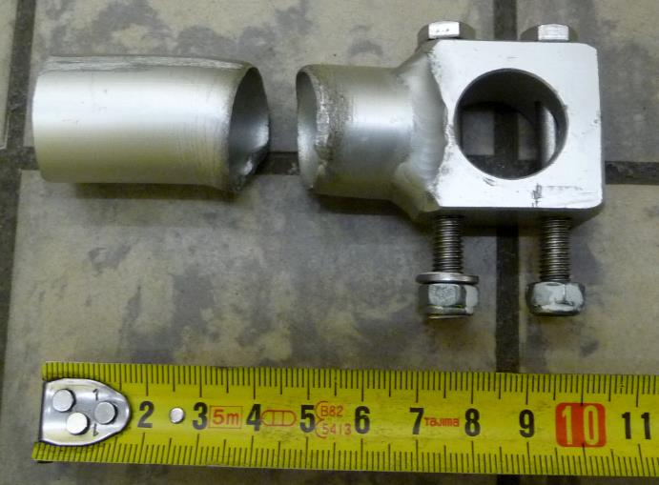
Case 1 : Helicopter main rotor cyclic pitch control stick
Cyclic stick ruptured close to the welding
Sent to 2 labs
Russia
Belgium
Notes:
Enter speaker notes here.

Slide 6
Case 1 : Helicopter main rotor cyclic pitch control stick
Conclusions from the Russian lab
based on study of the damaged stick only
Failure due to fatigue sollicitation: Action of variable bending and torsionnal stresses from transverse control and counteract forces
Second advice by Belgian lab
Study of the damaged stick
Study of a new, undamaged stick
Study of a stick destroyed with the application of a back and forth movement directly on the central column
Study of a stick destroyed with the application of a movement similar to in use conditions (load on the handle)
Notes:
Enter speaker notes here.

Slide 7
Case 1 : Helicopter main rotor cyclic pitch control stick
Central lever of cyclic stick before use
Made of AA606x (Al-Mg-Si)
Al Alloy | Chemical composition (wt.%)
 | Al | Mg | Si | Cu | Mn | Fe | Ti | Cr | Zn | Others (total)
6063 | balance | 0.45-0.90 | 0.20-0.60 | 0.10 max | 0.10 max | 0.35 max | 0.10 max | 0.10 max | 0.10 max | 0.15 max
6060 | balance | 0.35-0.60 | 0.30-0.60 | 0.10 max | 0.10 max | 0.10-0.30 | 0.10 max | 0.05 max | 0.15 max | 0.15 max
Notes:
Enter speaker notes here.

Slide 8
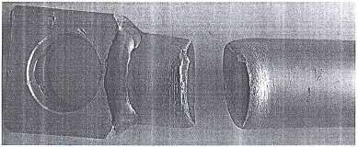
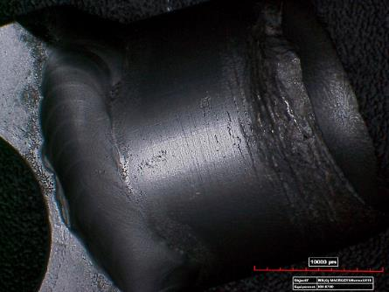
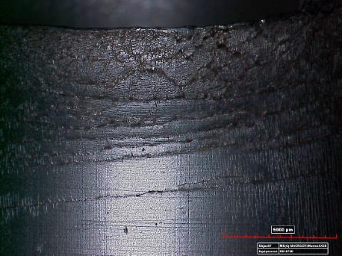
Case 1 : Helicopter main rotor cyclic pitch control stick
Damaged cyclic stick
Russian lab
Plastic deformation with « orange peel » effect
Due to the impacts of significant static loads exceeding the allowable operational values
From the effects of bending moment from a transverse load
But static load does not exceed 3.6 N of during flight ! And the system is absolutely not rigid.
Due to ductile fracture
Belgian lab
Plastic deformation lines
10 mm
10 mm
Notes:
Enter speaker notes here.

Slide 9
Case 1 : Helicopter main rotor cyclic pitch control stick
Belgian lab: Comparison between the fracture profile of
The damaged stick
A stick damaged by the application of movements similar to in use conditions (load on the handle)
A stick destroyed by the application of a back and forth movement directly on the central column
Stick damaged by the application of movements similar to in use conditions
stick destroyed by the application of a back and forth movement directly on the central column
Damaged cyclic stick
Notes:
Enter speaker notes here.

Slide 10
Case 1 : Helicopter main rotor cyclic pitch control stick
Important geometric deformation of the stick when damages occurs after application of a load on the handle
No geometric deformation of the stick in the case of damage caused by the application of a load directly on the central column
Damaged cyclic stick
Stick damaged by the applications of movements similar to in use conditions
Damaged cyclic stick
Stick damaged by the applications of movements similar to in use conditions
Stick damaged by the application of a back and forth sollicitation directly on the central column
Stick damaged by the application of a back and forth sollicitation directly on the central column
Notes:
Enter speaker notes here.

Slide 11
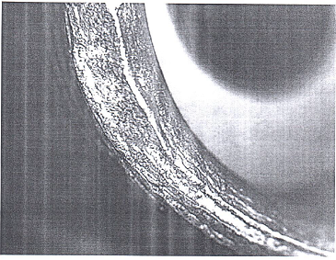
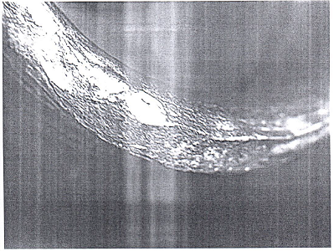
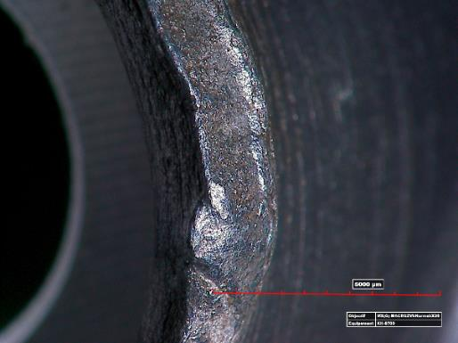
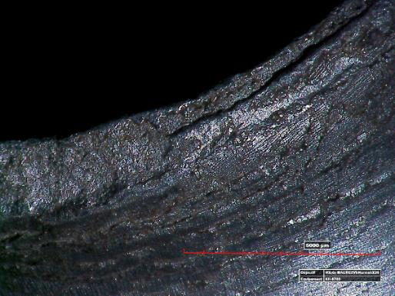
Case 1 : Helicopter main rotor cyclic pitch control stick
Damaged cyclic stick
Russian lab
Initial and secondary fatigue cracks on the fracture surface
Belgian lab
Thinning of the section of the column until the effective area becomes too weak to take the applied stresses
NOT a fatigue failure
5 mm
5 mm
Notes:
Enter speaker notes here.

Slide 12
Case 1 : Helicopter main rotor cyclic pitch control stick
Conclusions for this case
No more than 3.6 N of static load during flight
No excessive load in normal condition of use
No fatigue failure
No fatigue cracks
Plastic deformation
Thinning of the column section
Damage not possible in normal use during flight
Results similar to an improper load solicitation of the column
Notes:
In conclusion, for case 2, for two tubes analyzed, the standard used is not adequate with the use and one tube doesn’t mentioned the standard.
We observed an important localized corrosion with the presence of chlorine and sulfur in the corrosion products that could be coming from bacterial activities.

Slide 13
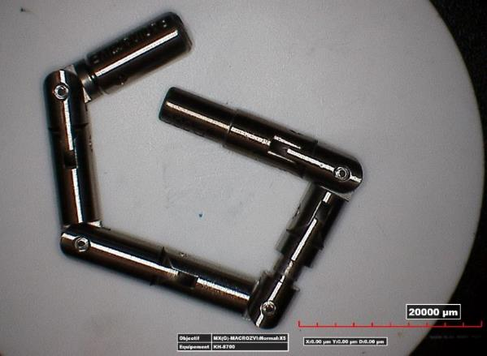
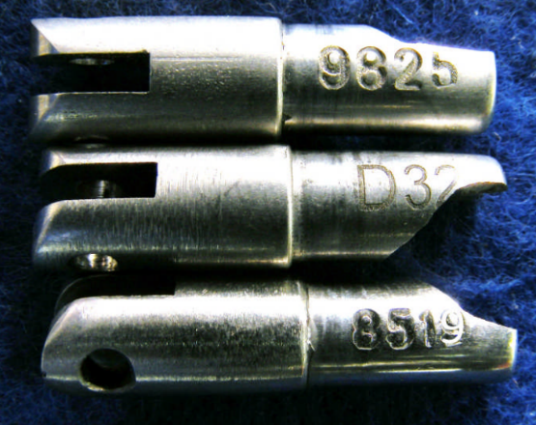
Case 2 : Stainless steel chain link used in radiographic applications
Made of martensitic stainless steel
Sent to 2 labs
South Africa
Belgium
Notes:
Enter speaker notes here.

Slide 14
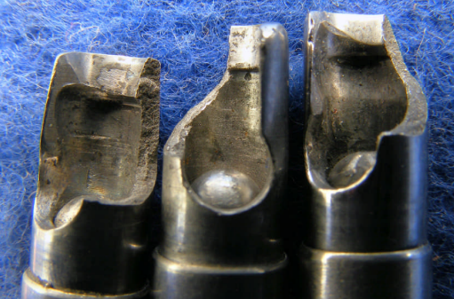
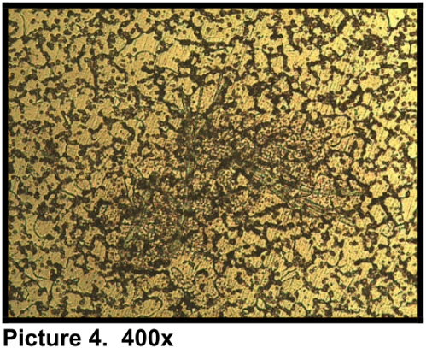
Case 2 : Stainless steel chain link used in radiographic applications
Conclusions from the South African lab
After macroscopic observations
No evidence of fatigue
After microscopic observations
Part made by powder metallurgy process
From Belgian lab
It is impossible to find evidence of failure with only macroscopic examination
Is it true ?
You need SEM observation !
Notes:
Enter speaker notes here.

Slide 15
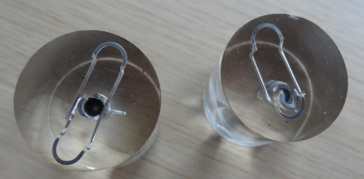
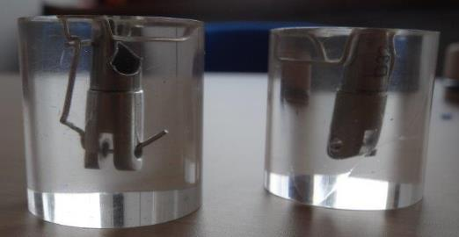
Case 2 : Stainless steel chain link used in radiographic applications
Sample preparation by the South African lab
For microscopic observation
The fractured surface area is inside the resin !
No information about the metallographic preparation and etchant used
Impossible to examine the fractured area with a microscope !
Notes:
Enter speaker notes here.

Slide 16
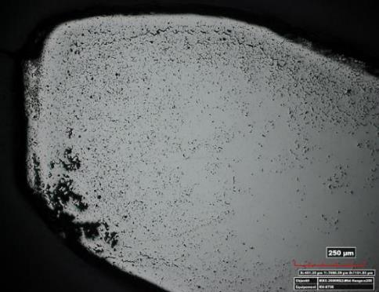
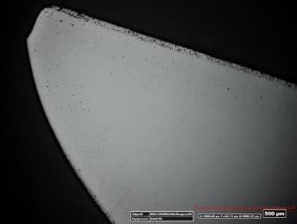
Case 2 : Stainless steel chain link used in radiographic applications
Belgian lab
Observation of South African lab sample as received
Corrosion ?
After new preparation
Evidence of corrosion phenomenon
MEB-EDX observations
Cr carbides
Intergranular corrosion
1 mm
500 µm
100 µm
Notes:
Enter speaker notes here.

Slide 17
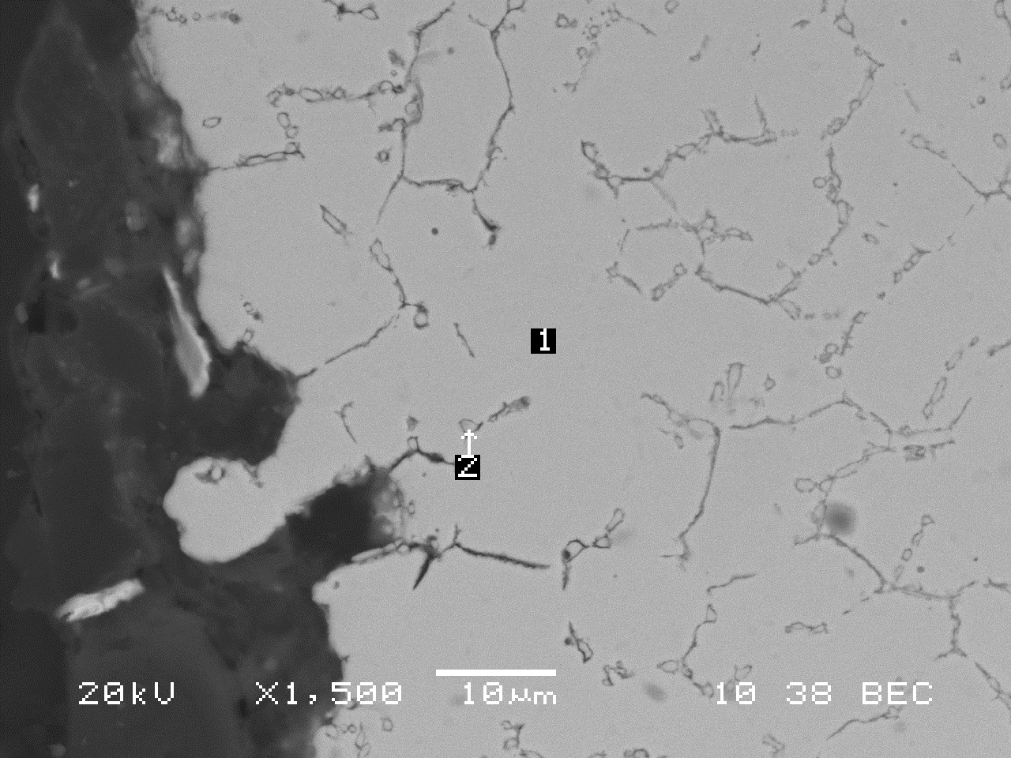
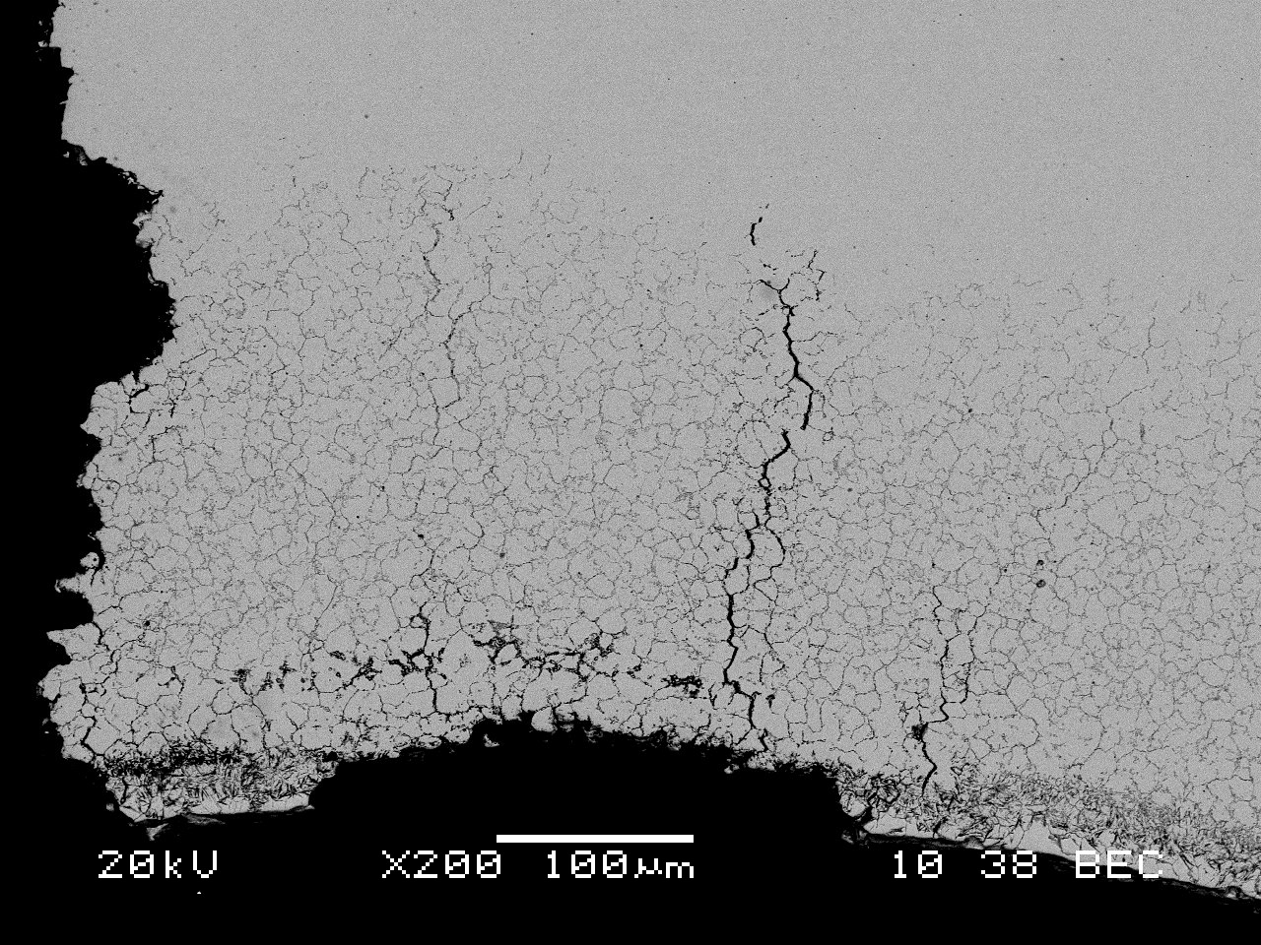
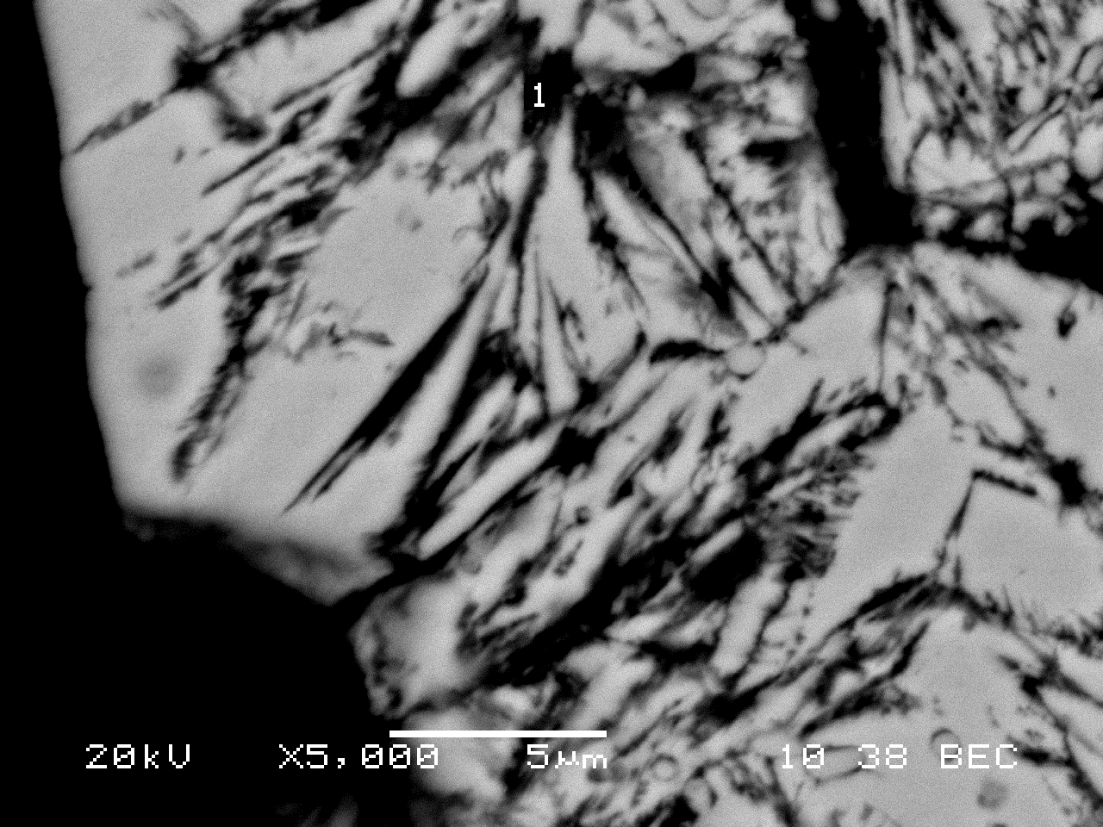
Case 2 : Stainless steel chain link used in radiographic applications
Belgian lab
Observation of South African lab sample as received
Corrosion ?
After new preparation
Evidence of corrosion phenomenon
MEB-EDX observations
Cr carbides - Intergranular corrosion
P content
About 1 wt.% of P
Notes:
Enter speaker notes here.

Slide 18
Case 2 : Stainless steel chain link used in radiographic applications
Conclusions for this case
No powder metallurgy fabrication
No examination of the fracture area by SEM
No evidence of fatigue fracture
Part manufactured from cast metal (melting, hot rolling, drawing, …)
Intergranular corrosion
Due to the presence of P-rich Cr carbides

Slide 19
Conclusions
It’s not because you sent your parts to a lab that the answers you got are the right ones
When unsure, contact another lab for a second opinion
FA requires in depth examination and full description of the testing and measurements to be credible
Thank you for your attention
Notes:
Enter speaker notes here.

